Slide 1

Shield Insurance Analysis

Slide 2

Company Overview
Shield Insurance Company offers dependable and all-inclusive insurance solutions tailored for both individuals and businesses.
With a strong emphasis on customer service and protection, Shield has built a reputation for delivering trustworthy coverage.
Its dedication to ensuring clients' peace of mind sets it apart in the insurance industry.

Slide 3
Objective
Highlight essential business metrics such as total customer count, overall revenue, daily revenue performance, customer acquisition trends, and month-over-month growth percentages.
Break down customer data by age group, city, and sales mode to uncover patterns in both customer behavior and revenue generation.
Visualize customer and revenue trends through interactive graphs with the ability to toggle views, and enable dynamic filtering across key dimensions like month, city, age group, and sales mode.
Dive deeper into sales performance by analyzing trends in sales modes, customer distribution, and revenue share across various age groups, cities, and sales channels.
Gain actionable insights by examining how different age segments interact with specific sales modes and policy types, along with their expected settlement behaviors.

Slide 4
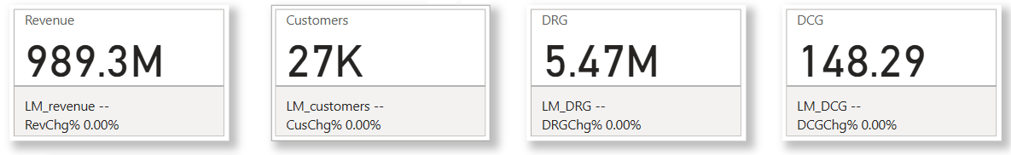
Key Performance Indicators
Total Revenue generated by Shield Insurance is of about ₹989.3M.
There are total 27K customers using shield Insurance.
The Daily Revenue Growth Rate(DRG) is about ₹5.5M, and Daily Customer Growth Rate(DCG) is 149.
Overall Key Performance Indicators(KPIs) shows that company has strong financial growth with good customer base.

Slide 5
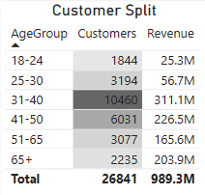
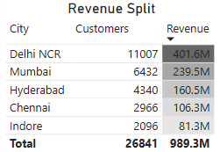
Revenue and Customer split by age group and city
Customers aged 31-40 lead in revenue contribution, bringing in 311M from a sizable base of 10,460 individuals.
The 41-50 age group ranks second, with a notable 226.5M in revenue, reflecting strong participation from 6,031 customers.
The 65+ segment, though smaller in size, stands out for its high value, contributing an impressive 203.9M despite having fewer customers—highlighting its potential as a premium segment.
Delhi NCR generates the largest revenue of 401.6M among all the cities, with the base of 11007 customer .
Mumbai becomes second largest contributor by generating revenue of 239.5M with 6432 customer base, followed by Hyderabad and Chennai.
While Indore generates the least revenue of 81.3M with base of 2096.

Slide 6
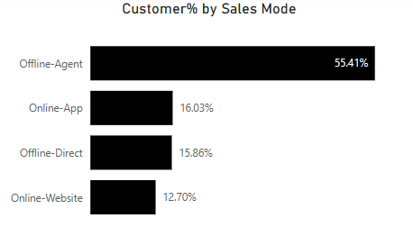
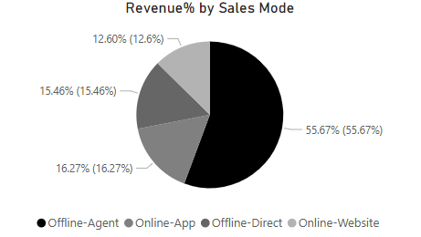
Sales mode analysis
The majority of Shield Insurance's customers are generated through Offline Agents i.e. 55.41% of total customers.
Other modes include App (16.03%), Direct (15.86%), and Website (12.70%), showing that offline channels (Agent and Direct) still play a significant role in sales.
Similarly, Agents also contribute the most in generating the revenue of 55.67% . The Offline-Agent segment holds the highest share at, followed by other online and offline channels.

Slide 7
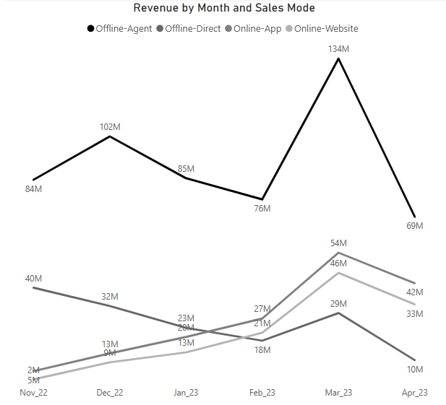
Revenue trends by month
Offline-Agent dominates overall revenue. It peaks massively in March 2023 (134M).
Offline-Direct steadily declines from 40M in November 2022 to 10M in April 2023.
Online-App and Online-Website show a gradual growth until March 2023, where they also peak — 54M (App) and 46M (Website).
Best month overall: March 2023 (for all sales modes).

Slide 8
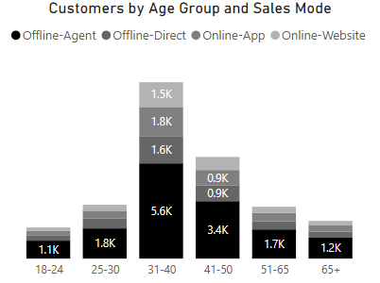
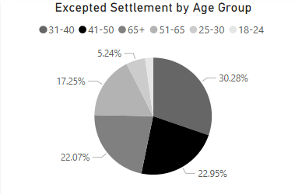
Age group analysis
31-40 age group is the largest customer segment (total around 10.5K customers), with Offline-Agent (5.6K) being the dominant channel.
18-24 and 65+ are the smallest customer groups (~1.1K–1.2K).
31-40 age group accounts for the highest share of settlements (30.28%). 41-50 age group follows closely at 22.95%.
Settlements are most common among customers aged 31-50. Younger customer (18-24 & 25-30) have much lower settlement rates.

Slide 9
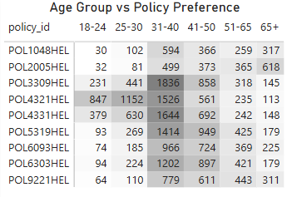
Age group vs policy Preference
31-40 is the "power" age group — highest customers and settlements, top policy buyers.
POL3309HEL and POL4321HEL dominate across multiple groups.
Older customers (65+) lean towards POL2005HEL.
Younger groups (18-24) have low policy enrollments overall, with POL3309HEL and POL4321HEL being their top picks too.

Slide 10
recommendation
Customer Base- Focus on growing the younger (18–24) and older (65+) customer bases to drive long-term growth.
Age Group Focus- Strengthen retention efforts for the high-revenue 31–40 age group with personalized offerings and loyalty programs.
Geographical Strategy- Replicate successful strategies from Delhi NCR across other high-potential regions like Mumbai and Chennai to accelerate market expansion.
Sales Mode - Enhance and promote digital platforms (App and Website) to better engage the younger demographic, who show a preference for online channels.
Policy & Risk Management -Develop specialized policies and proactive risk management frameworks targeting high-settlement groups (31–40, 41–50 age brackets).

Slide 11
Thank You!

